Slide 1
Bell Ringer
Most volcanoes are located along [divergent / transform / convergent] boundaries. Some volcanoes form from _______________ in the middle of tectonic plates.
Put your progress reports in the basket
Vocab quiz MONDAY
hot spots

Slide 2
Predicting Earthquakes

Slide 3
Volcanoes are caused by tectonic activity, and so are earthquakes!

Slide 4
Stresses and Strains
Earthquake – natural ground vibrations caused by fault movement or volcanic eruptions
Most earthquakes occur when the natural stresses between tectonic plates exceed the plates’ flexibility

Slide 5
Stresses and Strains
Tension
Stress – the forces that act on tectonic plates
Three types of stress:
Tension – pulls a material apart
Compression – pushing together
Shear – sliding past (can cause twisting)
Compression
Shear

Slide 6
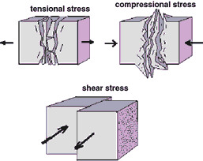
Stresses and Strains

Slide 7
Stresses and Strains
Tension
Tensional stress occurs at _________ plate boundaries.
Compressional stress occurs at __________ plate boundaries.
Shear stress occurs at _________ plate boundaries.
divergent
Compression
convergent
transform
Shear

Slide 8
Stresses and Strains
Stress – the force that deforms a plate
Strain – the actual deformation
Stress is the CAUSE and strain is the EFFECT
Stress
Strain
CAUSES

Slide 9
Stresses and Strains
Two types of strain:
Elastic – material deforms and then returns to its original shape after the stress is removed, like a rubber band
Ductile – material deforms and stays deformed after the stress is removed

Slide 10
Faults
When stress builds, rocks reach their elastic limit and eventually break (go from elastic to ductile strain), starting an earthquake
Fault – a fracture or break in rock that is the result of ductile strain

Slide 11
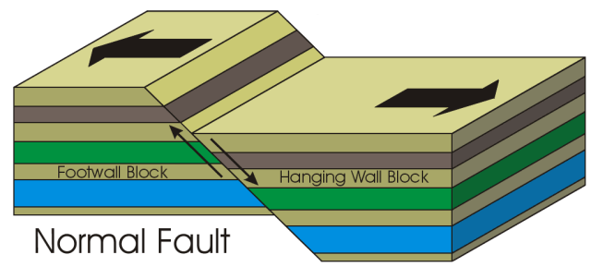
Faults
Two major parts of a fault:
Hanging Wall – hangs above
Footwall – your feet could walk up

Slide 12
Faults
She could use her feet to walk up the wall
Wall is hanging above her head

Slide 13
Faults
Three types of faults, based on the stresses exerted on them:
Normal Fault
Reverse Fault
Strike Slip (Lateral) Fault

Slide 14
Normal Fault
Normal fault – created when tension pulls plates apart
Hanging wall slides down the footwall partially due to gravity

Slide 15
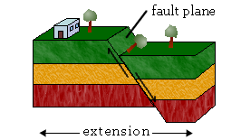
Normal Fault
Land movement – both horizontal and vertical
Extends the crust (stretching it out)

Slide 16
Normal Fault

Slide 17
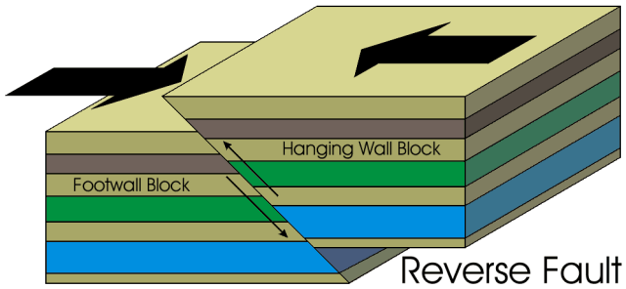
Reverse Fault
Reverse fault – created when compression pushes plates together
The reverse of the normal fault
The hanging wall rises above the footwall

Slide 18
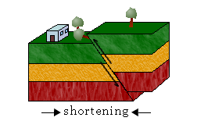
Reverse Fault
Land movement – both horizontal and vertical
Shortens the crust (compressing it)

Slide 19
Reverse Fault

Slide 20
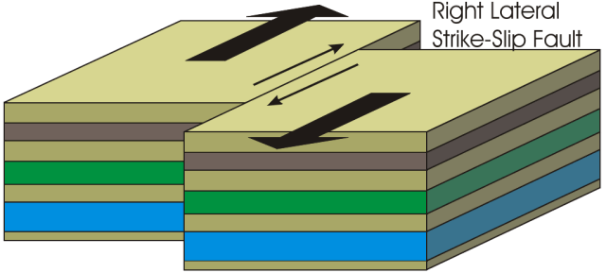
Strike Slip (Lateral) Fault
Strike Slip fault – created when shear forces make plates slide past one another
Land movement – primarily horizontal

Slide 21
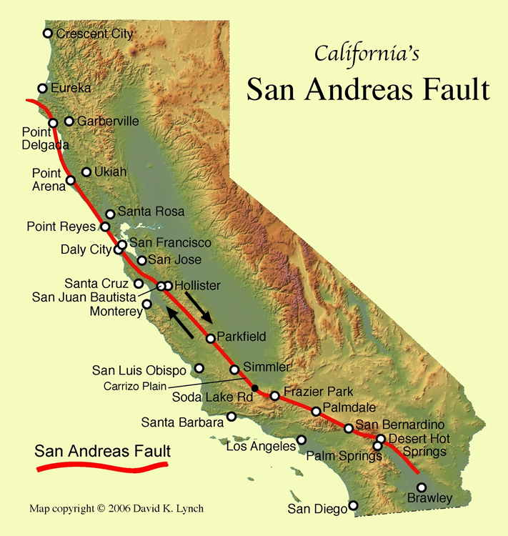
Strike Slip (Lateral) Fault
Example: San Andreas Fault, which creates most of California’s earthquakes

Slide 22
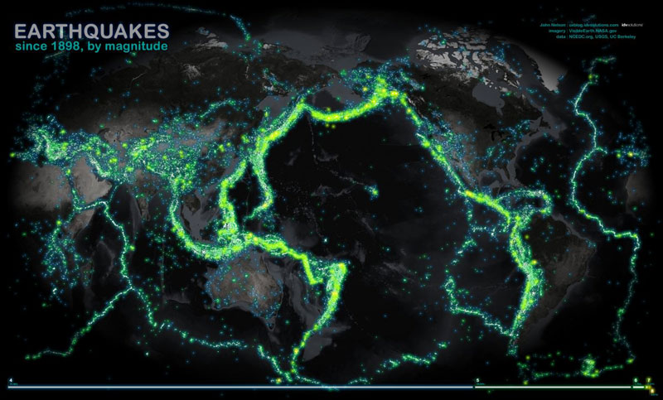
Predicting Earthquakes
Earthquakes are sudden and often occur without warning
However, some places are more likely to experience earthquakes than others
Earthquakes usually occur close to plate boundaries

Slide 23
Predicting Earthquakes
Seismic Risk – earthquake probability due to past seismic activity
Places that have had earthquakes before are more likely to have another earthquake in the future

Slide 24
Seismic Risk
What is one area with the highest risk for an earthquake?
Lowest risk?
Is NC a high or low risk for earthquakes?

Slide 25
Color the grass and rock layer X green.
Color rock layer Y yellow.
Color rock layer Z red.
Color the river blue.
Color the road black.
Color the railroad track brown.
Cut out your model, making sure to keep the tabs ON.

