Slide 1
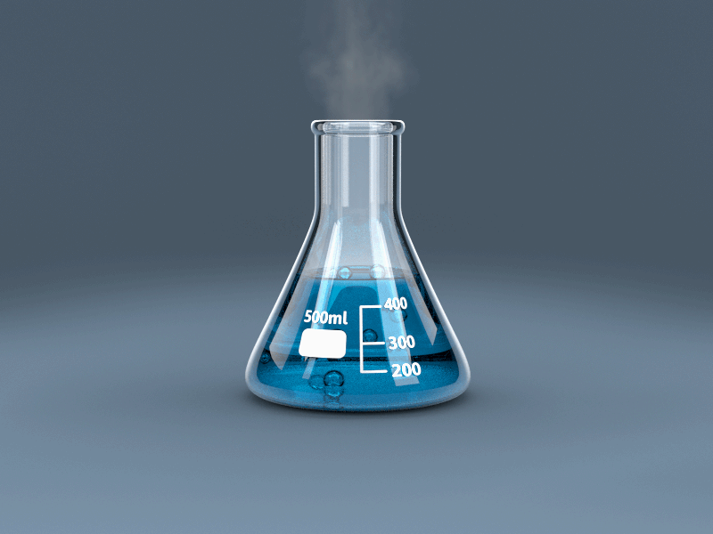
Welcome!

Slide 2
Who Am I?
I am Ms. Harper! I graduated from NC State with a degrees in biology and science education. I am still at NCSU working on my Masters degree and assisting in research. I have taught earth/environmental science, chemistry, and marine ecology. I am also the advisor for the Science National Honors Society and Science Olympiad. I am also a proud dog mom to a maltipoo, Julie, and a corgi, Finley.

Slide 3
About Chemistry
Chemistry is a course that builds beginning with the first unit. I cannot stress enough how important it is to not get behind in this class.
Chemistry is a mathematical based science, and every unit requires a strong math skillset. We generally advise that if a student is enrolled in Honors Chemistry then they are also enrolled in Honors Math 3.
They will need a calculator!
Chemistry cannot be memorized. It is necessary to understand the concepts and apply the concepts.
Students always have at least fifteen minutes in class to begin their homework and ask me for assistance.
Students are also responsible for checking their homework answers daily, available via my website.

Slide 4
Chemistry Grades
The grading system for this class is a total points system. Grades will come from tests (100 points each), quizzes (20-30 points), and labs (20-50 points), and homework checks (5 points). Grades can be determined at anytime by using the following formula:
Average = your total points earned X 100
total possible points

Slide 5
Personalization Time
Science personalization time is on Thursdays, and students will be required to use this time for makeup work.
If a student needs to makeup a test, however, that will need to be scheduled during a SMART lunch session on Monday.

Slide 6
Class Resources
Remind (Text @achemharp or @hchemharp to 81010)
www.msharperscience.weebly.com
Twitter: @msharperscience
Instagram: msharperscience
Email: lharper@wcpss.net

