Slide 1
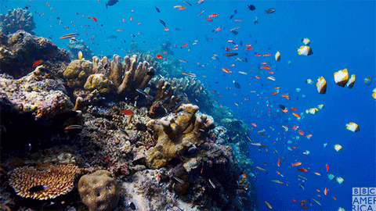
Welcome!

Slide 2
Who Am I?
I am Ms. Harper! I graduated from NC State with a degrees in biology and science education. I am still at NCSU working on my Masters degree and assisting in research. I have taught earth/environmental science, chemistry, and marine ecology. I am also the advisor for the Science National Honors Society and Science Olympiad. I am also a proud dog mom to a maltipoo, Julie, and a corgi, Finley.

Slide 3
About Marine Ecology
This course is split into two general categories: oceanography and marine biology.
The goal of this course is to teach students how to use their previous science knowledge and apply it to the marine environment, as well as to prepare them for college level science classes.
We will perform dissections in this class.
We will go on a Saturday field trip (more details coming soon).
Although I have a website, the best resource for students will be our Google classroom page.

Slide 4
Goal #1 this Year: Poster Presentations
Our biggest project in this class consists of students designing digital posters on current marine issues and presenting them in the media center – it’s always one of the students’ favorite activities in this course! (Those are the posters you see around the back of my room)
The kick is that students do not present the posters to me, they present them to YOU! In a few weeks I will be emailing to kindly ask you to stop by the media center and watch a few presentations and provide constructive feedback (it’s set up like a science fair). Last semester we had over 30 parents/grandparents/siblings show up to help and it was AMAZING!
This project will not be successful if parents do not attend, so please (if you are willing and able) support us in this endeavor!

Slide 5
Goal #2 this Year: Aquarium Science
I want to teach aquarium science this year. There are so many skills that students can learn from learning how to maintain an aquarium (water testing, nitrogen cycle, aquarium setup/maintenance/breakdown, aquaponics, gas exchange, etc.)
The goal is to divide students into groups of four and set up eight freshwater tanks filled with local critters.
However, I am still in desperate need of a lot of equipment. If you are willing and able (and still have that old aquarium out in the garage from that one time you thought a fish would be easier than a dog) please consider helping.
I am in need of: three tanks (at least ten gallons), water heaters, filters, undergravel filters, air pumps, tubing, water testing strips, thermometers, water primer, and gravel

Slide 6
Grades
The grading system for this class is a total points system. Grades will come from tests (100 points each), quizzes (20-30 points), and labs (20-50 points), and homework checks (5 points). Grades can be determined at anytime by using the following formula:
Average = your total points earned X 100
total possible points

Slide 7
Personalization Time
Science personalization time is on Thursdays, and students will be required to use this time for makeup work.
If a student needs to makeup a test, however, that will need to be scheduled during a SMART lunch session on Monday.

Slide 8
Class Resources
Remind (Text @marineecoh)
www.msharperscience.weebly.com
Twitter: @msharperscience
Instagram: msharperscience
Email: lharper@wcpss.net

